Slide 1


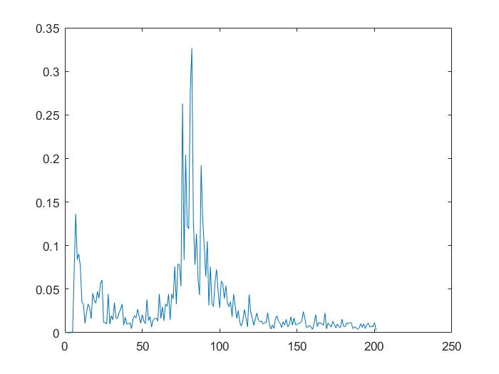
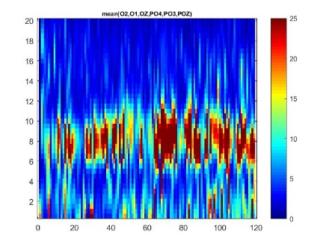
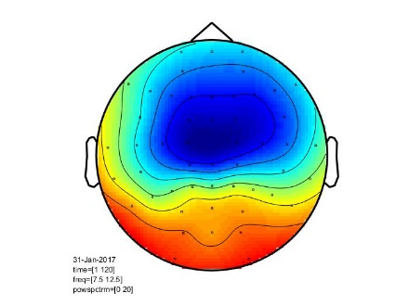
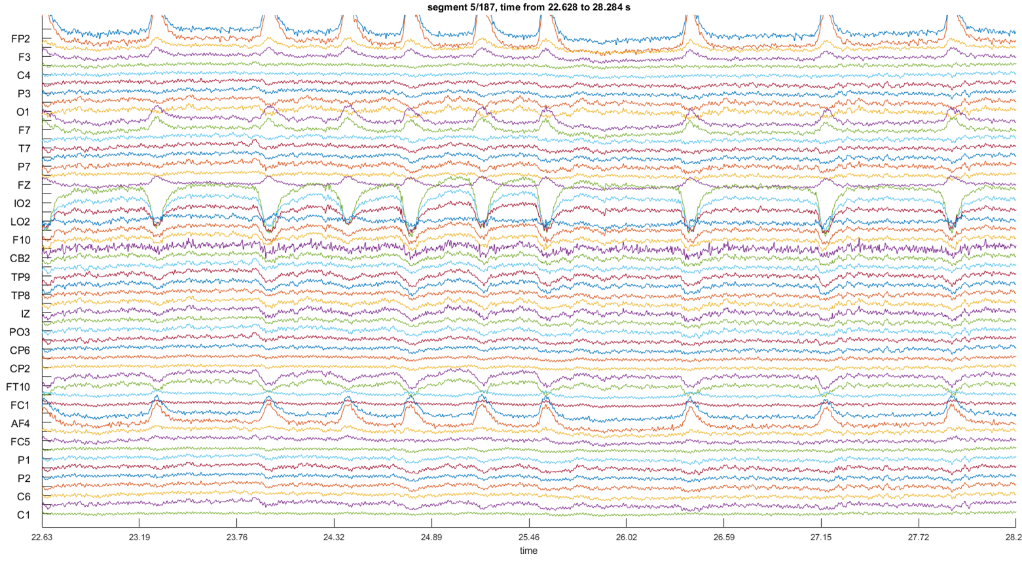
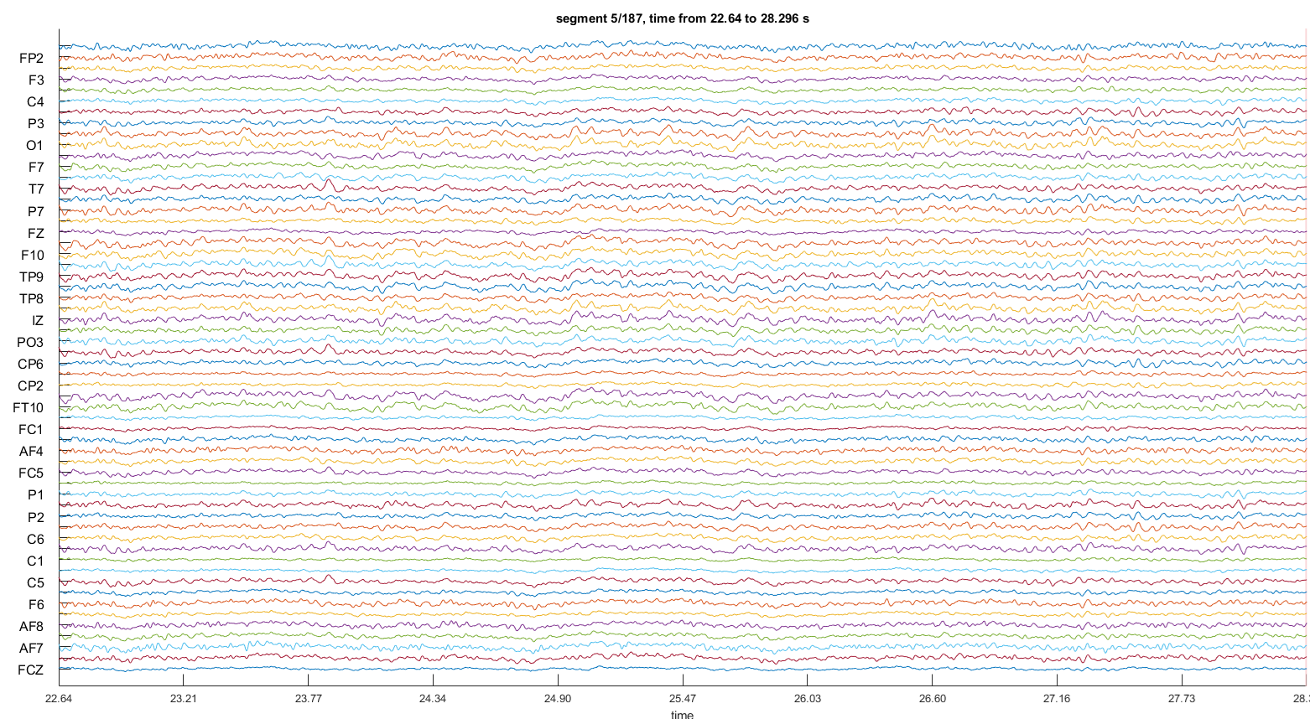
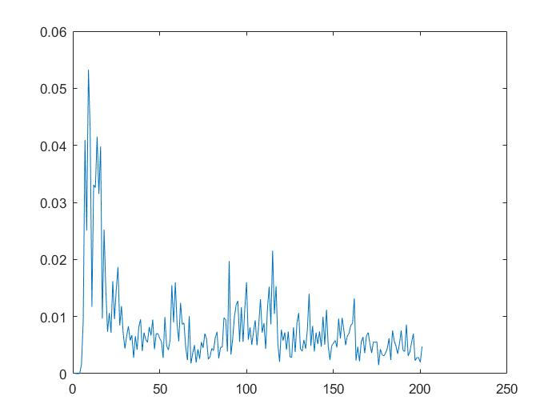
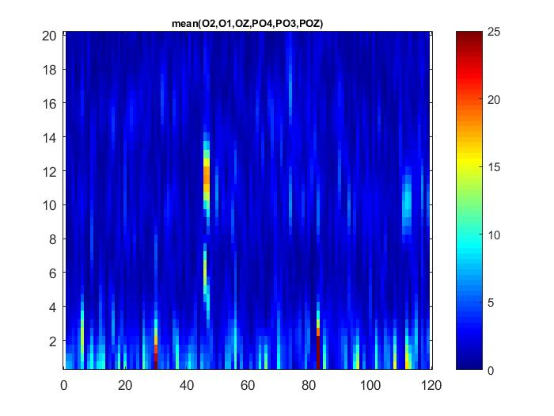
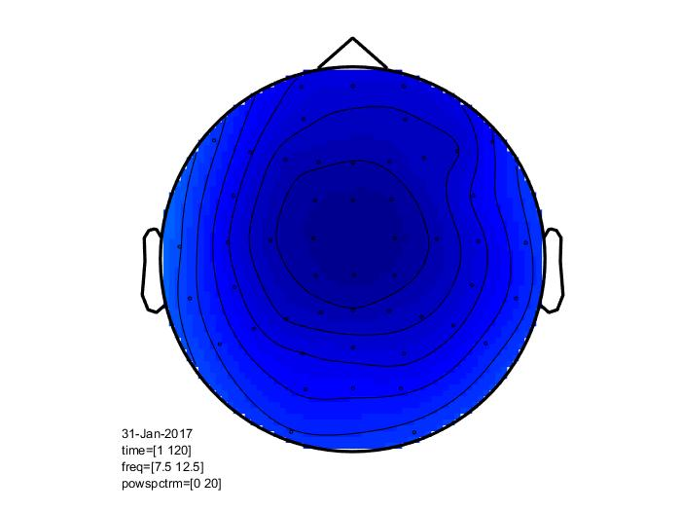
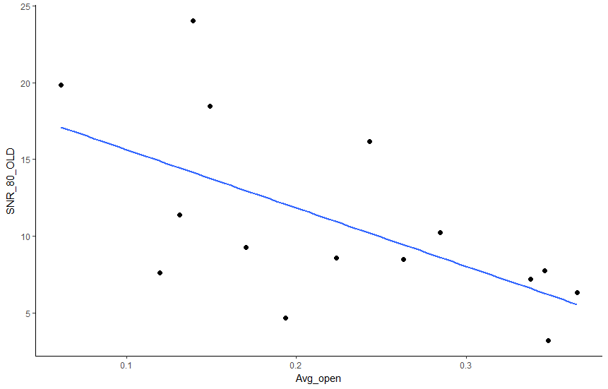
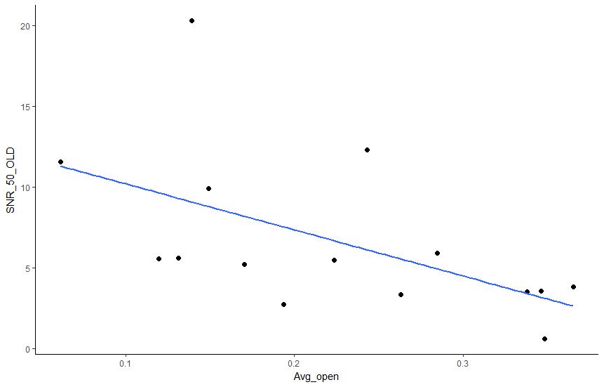

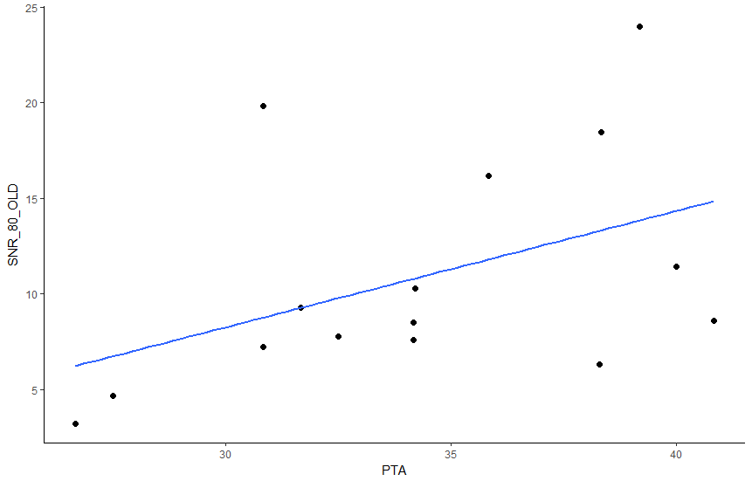

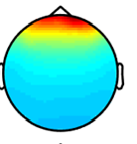
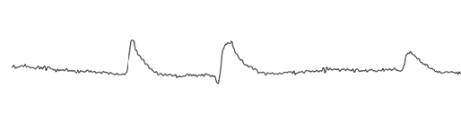
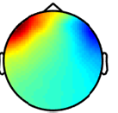
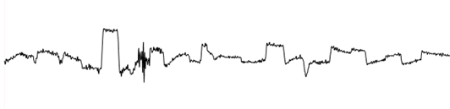
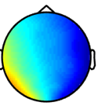
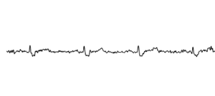
Are variations in speech-in-noise thresholds related to central inhibitory function?
Michael L. Smith¹, Michael L. Lee¹, Christi W. Miller¹, Yu-Hsiang Wu², Ruth A. Bentler², & Kelly L. Tremblay¹
1. Department of Speech & Hearing Sciences, University of Washington, Seattle, WA USA
2. Department of Communication Sciences & Disorders, University of Iowa, Iowa City, IA USA
1. Introduction
results
3. Results Continued
objectives
3. Results
Speech understanding in the presence of background noise is a major issue for individuals with hearing impairment
Effects of aging and hearing loss on central inhibitory function could potentially contribute to poor speech in noise (SiN) performance
Cortical alpha (7.5-12.5Hz) activity is an indirect measure of central inhibition, and relates to speech understanding in noise
Alpha rhythms effects on SiN testing has been well studied, but less is known about how individual resting state alpha relates to SiN performance.
Increased alpha activity is believed to aid in the suppression of background noise as the listener focuses on the relevant signal stream, however decreases in cortical areas related to attention
Purpose of the present study was to examine if an individual’s inhibitory function, as defined by their resting state alpha activity, would predict sentences in noise (SNR) thresholds
Resting state alpha activity in the eyes open condition varied among hearing aid patients
2. Methods
Participants: Adult bilateral hearing aid users (n = 15), age 59-81 (mean = 68.3)
Mild-moderate hearing loss
All subjects wore hearing aids for at least two years prior to testing
All testing was performed unaided
Baseline resting state activity was recorded in a silent, dark environment
EEG Recording
65 channel Neuroscan system
Online sampling rate of 1000Hz
Alternating 2 minute blocks of eyes open/eyes closed
Three blocks per condition
SNR Testing
Presented in sound field, single speaker 0° azimuth, 1m away
Noise:4-talker babble in international languages
English sentences presented -10 to +15 SNR in 5dB steps
Noise held constant at 65dB SPL
Data Analysis Pipeline
Alpha power was calculated in Fieldtrip, a MATLAB based toolbox
Trials were defined as eyes open or eyes closed
Bandpass filtered 0.5-50Hz
Down sampled to 250Hz
Independent Component Analysis (ICA) was used to remove biological artifacts such as eye blinks, eye movements, electrocardiogram (EKG), as well as noisy channels (i.e. 60Hz line noise)
ICA was conducted over the continuous EEG recording data
Average of 3-5 components removed per subject
background
FFT – occipital channels
Alpha power averaged across occipital channels
Topo-power in alpha band
Figure 2. Individual subject differences in time frequency data during the eyes open condition. Notice in the top row (subject 1) the increased activation in the alpha band (7.5-12.5Hz), while the bottom row (subject 2) shows no activation across different frequency bands.
Decreased SNR thresholds were associated with increased alpha power
4. conclusions
Figure 3. Significant correlations between SNR thresholds and alpha band power were observed
References
Conclusion 1
Conclusion 2
Conclusion 3
Figure 1. Raw EEG data before and after removal of biological artifacts using ICA.
Figure 4. Significant correlations between SNR thresholds and pure tone average thresholds were observed

